Slide 1
Essential Elements of
Hydrological Information Systems
Module 15
Some slides taken from HP-2 training module by Mark Heggli
Revised by: Steve Lipscomb

Slide 2
Examples that refer to products are intended for illustrative purposes only, and do not imply an endorsement or recommendation of any particular product

Slide 3
Hydrological Information System
(HIS)
A comprehensive Hydrological Information System should be viewed as a valuable national resource equal to other resources that enable India to have economic success and a good quality of life.
As such it must be well designed, implemented, protected, and preserved which is why we’re here this week.

Slide 4
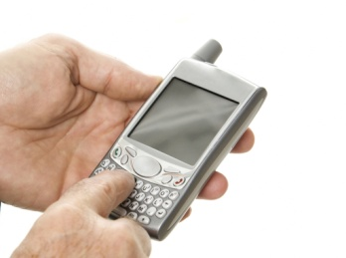
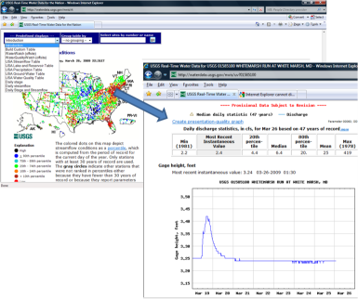
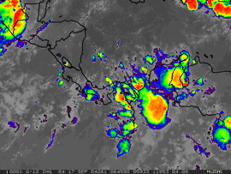
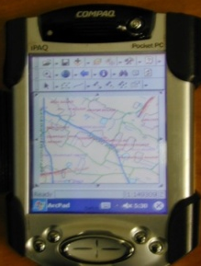
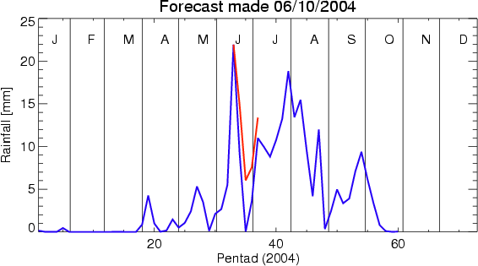
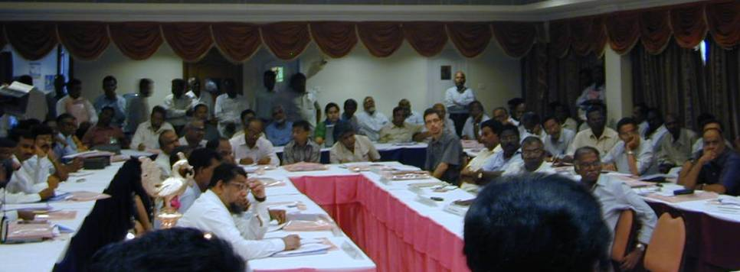

Some Modern HIS Benefits
Modeling Verification
Dissemination
Understanding Hydrological Processes
HIS
Public
Awareness
Flood Forecasting
Policy and Planning
Notes:
Modernized HIS Benefits. The first thing we should look at are the benefits you should expect from a well thought out HIS implementation. <c> Your HIS will be the central repository of information that is collected from not only your remote monitoring network, but also derivative products such as flood forecasts as well as other information you may find useful. You can also collect information provided by other institutions to make your HIS a one stop site where your stakeholders can collect information that can be used to their benefit.
For instance, your HIS <c> can show model verification, <c> ground truth from satellites, <c> DSS forecast products for water elevation and flow, <c> information for your stakeholders, <c> as well as dissemination tools for the general public. There are so many products the HIS can deliver to you. I am quite certain that the benefits of your HIS will only expand with time.

Slide 5
Five Essential Elements of a Hydrological Information System (HIS)
Network Design
Quality Management
System
Technology
HIS
Training
Data Management

Slide 6
Network Design
A complete network design addresses the following questions that pertain to the collection of hydrological data
  What hydrological variables need to be observed?
  Where do hydrological observations need to be observed?
  What is the duration of the observation program?
  How accurate should the observations be?

Slide 7
Network Design
  Which hydrological variables need to be observed???
    Surface water
      Stage (water level)
      Discharge
      Velocity
      Bathymetry
    Groundwater
      Water level
      Velocity and direction
    Water Quality
      Temperature
      pH
      Conductivity
      Dissolved oxygen
      Turbidity
      Sediment
        Suspended load
        Bedload

Slide 8
Network Design
Where do hydrological observations need to be observed?
  It depends upon the objective
    Flood warning vs flood risk
    Hydropower operations vs hydropower feasibility
    These objectives sound similar to the casual observer but require monitoring at completely different locations
  Data for warnings and operational needs are very site-specific whereas risk and feasibility assessments require basin-scale data.

Slide 9
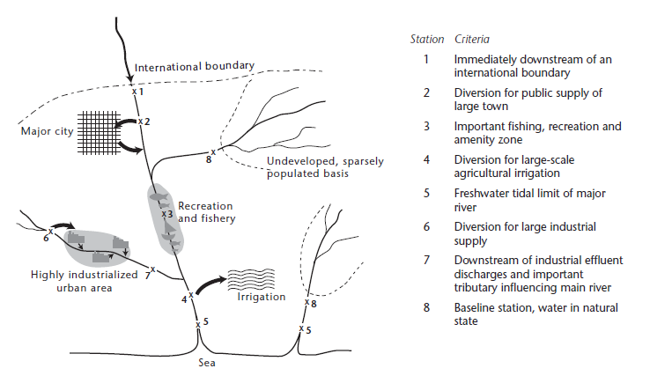
Where is monitoring needed?

Slide 10
Where is monitoring needed?
Additional monitoring locations to consider
  Flood warning stations near population centers or important infrastructure.
  Inflow, outflow, and pool elevation for irrigation and hydropower reservoirs.
  Special projects or model calibration.
  GW and QW require their own unique considerations.

Slide 11
Network Design
What is the duration of the observation program?
  A well-designed long-term network will satisfy many objectives.
    Feasibility studies
    Trends
  However, your network may also include short-term stations to meet certain project-oriented objectives
    Time of travel studies
    GW contaminant plume analysis
    Model development
    Regulatory compliance
  These stations may require different types of instrumentation. Sometimes more sophisticated, sometimes less.

Slide 12
Network Design
How accurate should the observations be?
  There is more to the HIS network’s accuracy than just the accuracy of the water level sensor.
  Water level is actually the easiest part of streamgauging but by itself is often of little practical value.
  Discharge is usually the most important parameter.
    Planning studies
    Models
    Water-quality and sediment loads
    Flood frequency
    Reservoir and canal operations

Slide 13
Network Design
How can we achieve accuracy in discharge monitoring
    Water level is the starting point
      Sensor accuracy
      Datum establishment and maintenance
    Frequency of visits for discharge measurements (rating and shift analyses)
    Quality of discharge measurements
    Discharge measurements covering the entire range from low to high flows.

Slide 14
Network Design
How can we achieve accuracy in water-quality monitoring
Calibration of QW sensors
Integrated or grab samples? Does it make a difference?
Frequency of visits for samples. It depends on the objective.
  Annually
  Seasonally
  Monthly
  Weekly
  Continuous

Slide 15
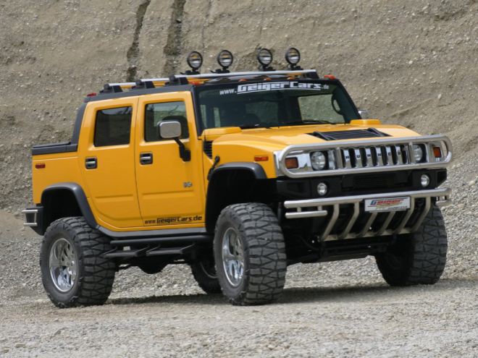

Network Design
  The bottom line is there is no one-size-fits-all answer! Just like there’s no single perfect car design.
  Each station has it’s own requirements. Sometimes they’re similar to other stations but sometimes they’re unique.
  Your design needs to address those unique requirements.

Slide 16
Network Design:
Some Key Principles
Address all current objectives
Anticipate future objectives
Build in ability to scale up as needed
Choose appropriate solutions for each site
Avoid data redundancy or gaps
Design in quality from the beginning

Slide 17
Technology Components of HIS
Telecommunications
Data Center
Data Logger /Sensor

Slide 18

Factors when considering sensors, data loggers, and telemetry devices
  Reliability
  Accuracy and precision
  Cost
  Product Support (technical inquiries, repairs, warranties)
  Maintenance
  Availability of training

Slide 19
Additional factors to consider :
Data loggers, sensors, and telecommunications
Ease of use (minimum training requirements)
Flexible but not overly complicated (new parameters can be added with ease)
  Transmitter supports multiple telemetry options for future enhancements (SCADA)
  Multi-parameter sonde for future addition of QW sensors
Cost – Why pay too much? Get multiple bids.
Balancing these factors to make an appropriate technology decision requires familiarity with objectives, site characteristics, and instrument capabilities.

Slide 20
Factors when considering Data Center technology
  System Reliability
  Operational costs (software licenses)
  Well recognized solutions
  Redundant Systems (UPS, data backup, process mirroring)
  Product Support (technical support, warranties)

Slide 21
Data Management:
Key benefits of a good Data Management System (DMS)
Automation of key processes
  Input of data to data base
  Error checking
  Archival (historic and real-time)
Seamless integration of analytical software and data
Data security
  Backups
  Mirroring
Data access
  Web-based for efficient sharing of data
  Easily limit access to data and analyses when necessary

Slide 22
Training:
Benefits of a comprehensive training program
Provides standardized training for new employees
Provides advanced training for existing employees
On-line training can be taken at any time and without incurring high recurring costs
Provides for continual professional development
Increases productivity and efficiency

Slide 23
Quality Management System:
Developing a Quality Assurance Plan for every process will result in high-quality data.
Benefits
  Optimizes both field and office methods
  Increases productivity and efficiency
  Ensures prompt corrective action when problems arise
  Enhances image of the responsible agency
  Quality is built into the process rather than attempting to add it later

Slide 24
Hydrological Information System
Quality is Key
During my career with the USGS some accused our agency of being too obsessive with how we collect and analyze data. But when they absolutely had to have the best quality data available it was the USGS they would turn to.
There’s a saying that “If you take care of the pennies, the dollars will take care of themselves.” This applies to hydrologic data collection.
There’s another saying “If you buy a quality you’ll never regret it.” The same applies to building a world-class Hydrologic Information System for India.

Slide 25
Questions or Comments?

